Slide 1

Object Oriented Programming using Java

Slide 2
Course Credits
Course Type: | Foundation |  | L | T | P | Credits
 |  |  | 3 | 0 | 4 | 5

Slide 3
Course Outcome
Implement
CLO1: Implement a given algorithm in Java by using standard programming constructs such as, looping, methods, and packages etc.
Explain
CLO2: Explain the output of a given Java program and debug errors in a given program.
Write
CLO3: Write simple programs using the features of object-oriented programming language such as, encapsulation, polymorphism, inheritance, etc.

Slide 4
Evaluation Component
Components of Course Evaluation | Percentage
Mid Term Examination | 15
End Term Examination | 35
Continuous Lab Evaluation | 20
Quiz | 10
Assignment | 5
Project | 15

Slide 5
Resources
Edx-Object Oriented Programming in Java.
https://www.edx.org/course/introduction-to-java-programming-starting-to-code
Coursera-Object Oriented Programming in Java Specialization.
https://www.coursera.org/specializations/object-oriented-programming
MIT OpenCourseWare-Introduction to Programming in Java.
https://ocw.mit.edu/courses/electrical-engineering-and-computer-science/6-092-introduction-to-programming-in-java-january-iap-2010/

Slide 6
Lab Tool
Lab Platform
CodeZinger (Continuous Labs & Exams)
IDE
Eclipse
Netbeans
Jdoodle\Onlinegdb

Slide 7
Fundamentals

Slide 8
Outline
Introduction to Java
Bytecode
JVM Architecture
Applications of Java
Types of Java Application
History of Java
Features of Java
Simple Java Program

Slide 9
Introduction to Java
S
Java is a general purpose programming language.
It is High Level language.
Java was originally developed by James Gosling at Sun Microsystems in 1995.
Java is a language that is platform independent.
A platform is the hardware and software environment in which a programs run.
Java has its own Java Runtime Environment (JRE) and API.

Slide 10
Introduction to Java (Cont…)
S
Java code is once compiled, it can run on any platform without recompiling or any kind of modification.
“Write Once Run Anywhere”
The aforementioned feature of Java is supported by Java Virtual Machine (JVM).
First, Java code is complied into bytecode. This bytecode gets interpreted on different machines. Java bytecode is the result of the compilation of a Java program, an intermediate representation of that program which is machine independent.

Slide 11
Bytecode
S
When we write a program in Java, at first, the compiler compiles the program and a bytecode is generated.
When we wish to run this .class file on any other platform, we can do so.
After the first compilation, the generated bytecode is now run by the Java Virtual Machine and the processor is not in consideration (only java installation is required).
Implementation of JVM is based on stack.

Slide 12
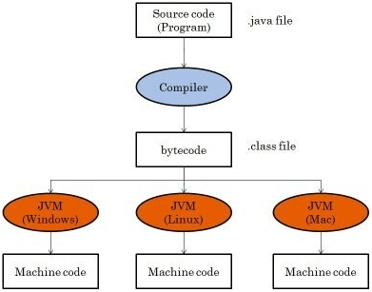
Bytecode (Cont…)
S
Fig 1: Bytecode

Slide 13
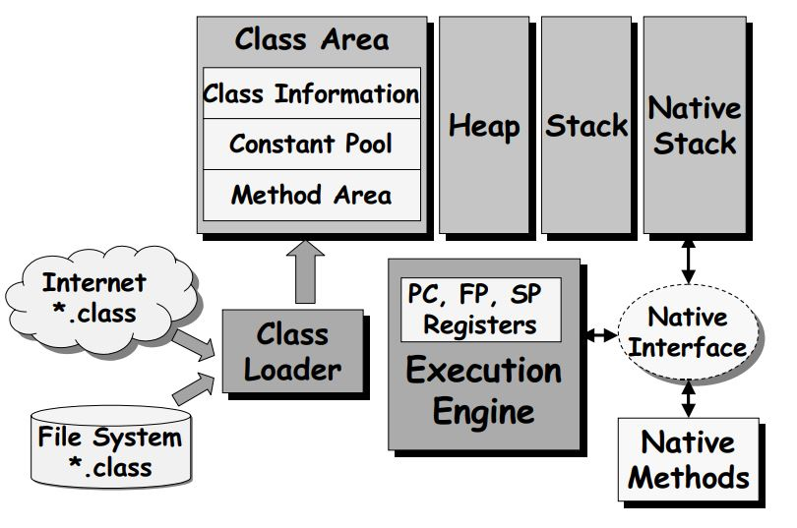
JVM Architecture
Fig 2: JVM architecture

Slide 14
Applications of Java
S
Approx. 3 Billion devices run java. Some of them are as follows:
Desktop applications
Web applications
Enterprise applications (banking)
Mobile
Embedded system
Smart card
Robotics
Games

Slide 15
Types of Java Application
S
There are 4 type of java applications:
Standalone Application: An application that install on each system
(AWT and Swing are used).
Web Application: An application that runs on the server side and creates dynamic page (servlet, jsp, etc are used).
Enterprise Application: An application that is distributed in nature, such as banking applications. It has the advantage of high level security and load balancing.
Mobile Application: An application that is created for mobile devices
(Android and Java ME are used).

Slide 16
History of Java
S
James Gosling, Mike Sheridan, and Patrick Naughton initiated the Java language project in June 1991. The small team of sun engineers called Green Team.
Firstly, it was called "Greentalk" by James Gosling and file extension was .gt.
After that, it was called Oak and developed as a part of the Green project.
In 1995, Oak was renamed as "Java“.
JDK 1.0 released in 23 Jan 1996.

Slide 17
Features of Java
S
There are many features of Java:
Object-oriented
Platform independent
Secure
Robust
Portable
Dynamic
High performance
Multithread
Distribute

Slide 18
Simple Java Program
S
To create a simple java program, you need to create a class that contains main method.
class Hello
{
public static void main(String args[])
{
System.out.println(“Hello World”);
}
}

Slide 19
Simple Java Program (Cont…)
S
Save: Save as Hello.java
To compile: javac Hello.java
To execute: java Hello
Output: Hello World

Slide 20
Simple Java Program (Cont…)
S
class keyword is used to declare a class.
public keyword is an access modifier, which represents visibility. It means it is visible to all.
static is a keyword. If we declare any method as static, it is known as the static method. The core advantage of the static method is that there is no need to create an object to invoke the static method. The main method is executed by the JVM, so it doesn't require to create an object to invoke the main method. Thus, it saves memory.
void is the return type of the method. It means it doesn't return any value.
main represents the starting point of the program.
String args [] is an array of strings which stores arguments passed by command line while starting a program.
System.out.println() is used to print statement. Here, System is a class, out is
the object of PrintStream class, println() is the method of PrintStream class.
14

Slide 21
Simple Java Program (Cont…)
S
The subscript notation in Java array can be used after type, before the variable or after the variable.
public static void main(String[] args)
public static void main(String []args)
public static void main(String args[])

Slide 22
Simple Java Program (Cont…)
S
Valid Java main method signature:
public static void main(String[] args)
public static void main(String []args)
public static void main(String args[])
public static void main(String... args)
static public void main(String[] args)

Slide 23
Simple Java Program (Cont…)
S
Invalid Java main method signature:
public void main(String[] args)
static void main(String[] args)
public void static main(String[] args)

Slide 24
Simple Java Program (Cont…)
S
Giving a semicolon at the end of a class is optional in Java.
class Hello
{
public static void main(String args[])
{
System.out.println(“Hello World”);
}
};

Slide 25
Thank You ?

